Slide 1
Early Bird Mid-Level Prototype Designs

Slide 2

SuperSin Design
Ideas for improvement on next slide →
The design spins very quickly due to its large blades and the lack of air that is able to escape through the blades. Additionally, the curved shape of the blades allows them to be propelled easily by catching wind and gaining great amounts of speed. On the other hand, although it can spin very well, the design will need some major aesthetic enhancements.

Slide 3
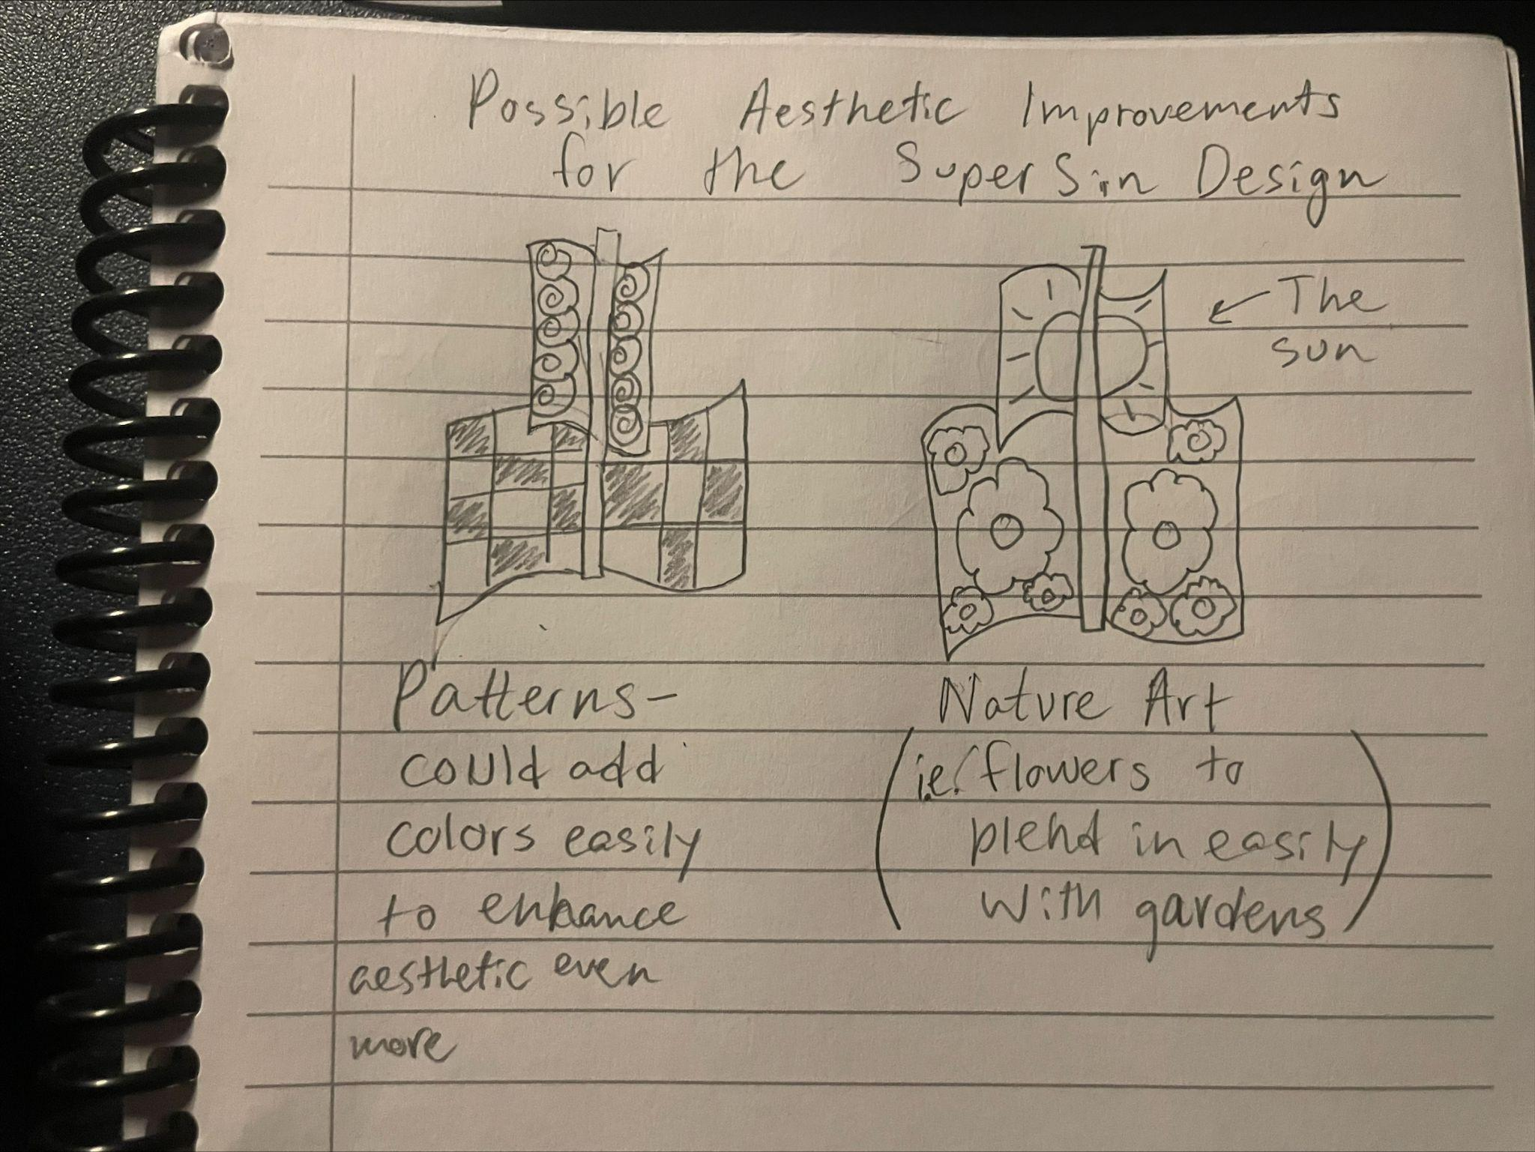

Slide 4
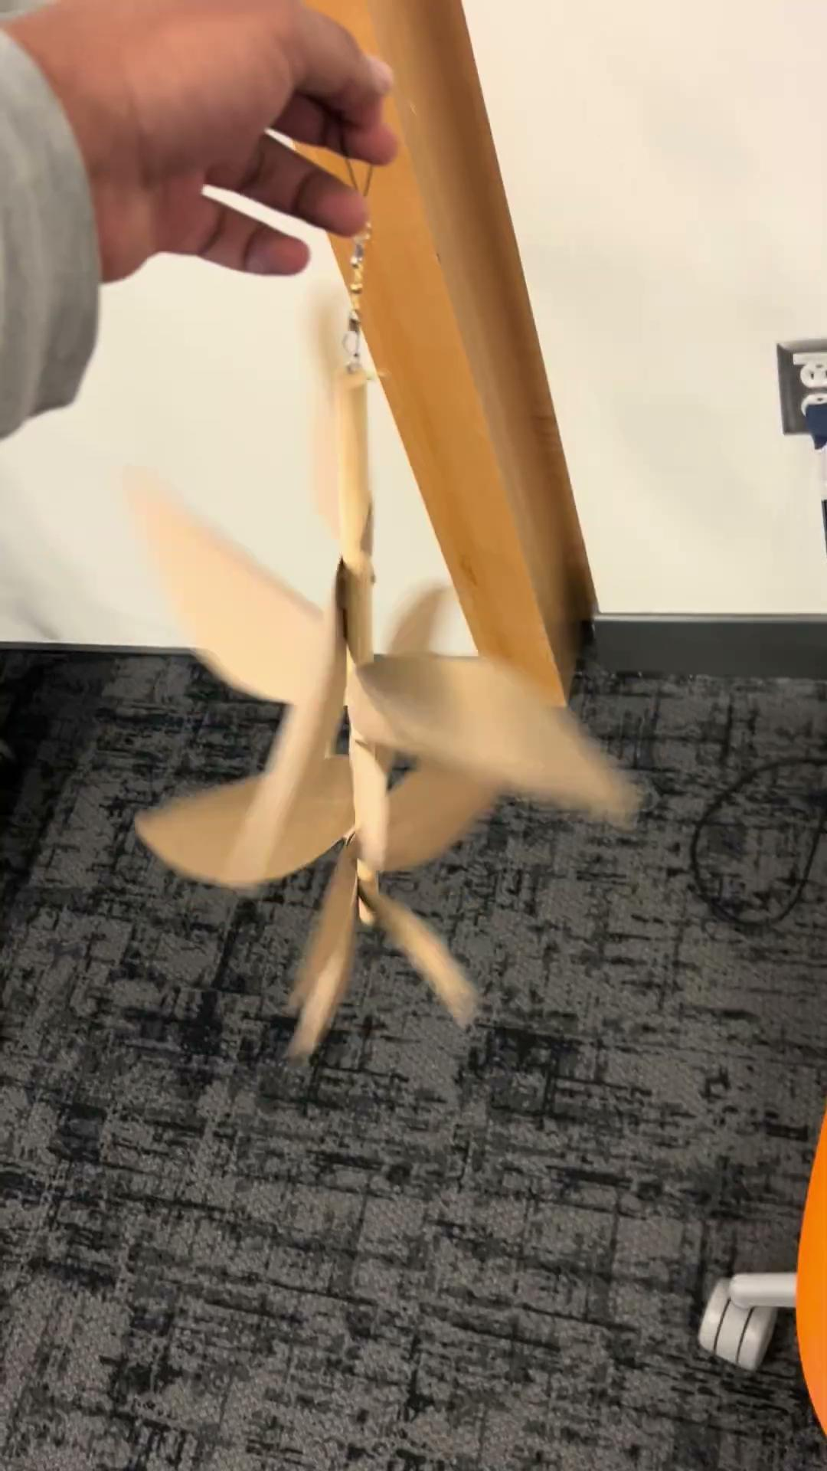
Pinecone Design
The design has some biotic mimicry in the form of a pinecone. Mimicking nature is a great way of making designs look aesthetically pleasing. The design uses different sized “leaf” blades increasing in size the higher up on the design it goes. The lack of symmetry is good because it really shows the dynamic aspects of natural bodies.

Slide 5
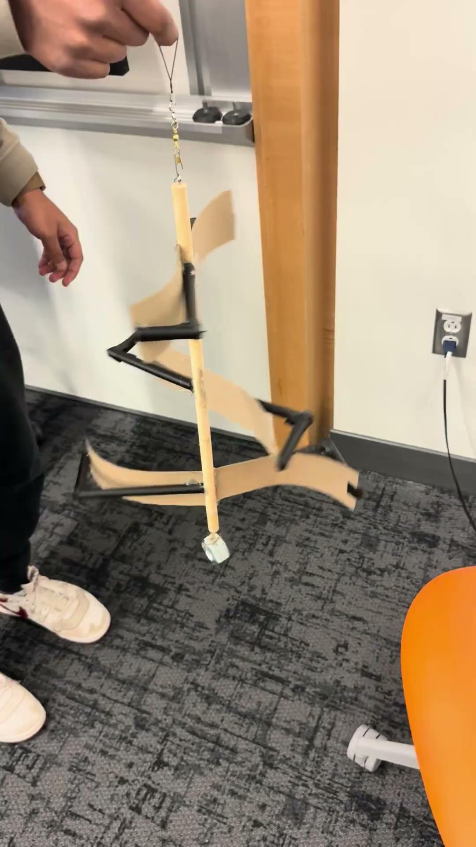
Christmas Tree Design
This wind turbine was designed to resemble a Christmas tree. Since trees are common in nature, this design could help the turbine blend more naturally into its surroundings. It has 6 blades total that decrease in size toward the top to create the tree-like shape. The blades are placed on opposite sides and angled in different directions to capture as much wind as possible and allow the turbine to spin effectively. Each blade is also positioned about 20–30 degrees from the blade below to improve both the appearance and the movement of the design. Lastly, supports were added behind each blade to help maintain their curved shape and provide better stability.

Slide 6
